Slide 1

Mobile Commerce:
The Business of Time
6-<number>

Slide 2
The focus of this chapter is on several learning objectives
The basic concept of wireless commerce
The reasons for going wireless
How wireless technology is employed
Wireless security
The role of cellular phones in wireless commerce
6-<number>

Slide 3
Learning Objectives (Cont’d)
Factors in designing a wireless local network
The protocols for M-commerce architecture
The dawn of wireless banking
6-<number>

Slide 4
Wireless Communication
Transmitting signals over radio waves instead of wires
Wireless LAN (WLAN) is a standard for wireless networking
WLAN is becoming the backbone of mobile or m-commerce
Wireless networks are just as effective as wired systems
6-<number>

Slide 5
What is M-Commerce?
Transactions and payments conducted in a non-PC-based environment
The transmission of user data (e.g., e-mail, spreadsheet) without wires
The management of the processes that handle the product or service needs of a consumer via a mobile phone
Use of wireless devices to facilitate the sale of products and services, anytime, anywhere
6-<number>

Slide 6
M-Commerce Categories of Services
Information-based consumer services
Transaction services
Location-centric, personalized services that anticipate your purchases based on your location and data stored in your “profile”
6-<number>

Slide 7
History of Wireless Communication
1895, Marconi successfully transmitted radio waves without using wires
1940s, two-way car radios were installed by police, government agencies, and utility companies
1969, introduction of a commercial cellular radio operation on trains running from New York City to Washington, D.C.
1978, introduction of analog-based cellular telephone services to the general public
6-<number>

Slide 8
Three Generations of Digital Cellular Technology
The first generation operates in the 800-900 MHz (megahertz) frequency spectrum
  832 frequencies available for transmission
  Lock the channel for the caller and the recipient through the telephone company’s switch
2G started in the early 1990s
  Operates between 9.6 Kbps and 14.4 Kbps in the 800 MHz and 1.9 GHz frequencies
  Digital, not analog transmission
  Lacks a universal system of wireless communication and lack of the bandwidth inherent in a circuit-switched network
6-<number>

Slide 9
Three Generations of Digital Cellular Technology (Cont’d)
2.5 generation is somewhere in later stages of 2G
  “always on” capability
  Packet-switched design
3G, marks the beginning of a uniform and global worldwide standard for cellular wireless communication, capabilities include:
  Streaming video
  Two-way voice over IP
  Internet traffic with high quality graphics and plug-ins for a wireless phone
  Transmission speeds of 144 Kbps for fast-moving mobile wireless devices
6-<number>

Slide 10
Three Generations of Digital Cellular Technology (Cont’d)
Future 4G technology extends 3G capacity by one order of magnitude
6-<number>

Slide 11
Key Benefits
Time and money
Anywhere functionality to stay competitive
Freedom of choice
Productivity and flexibility in coordination
Location-centricity
6-<number>

Slide 12
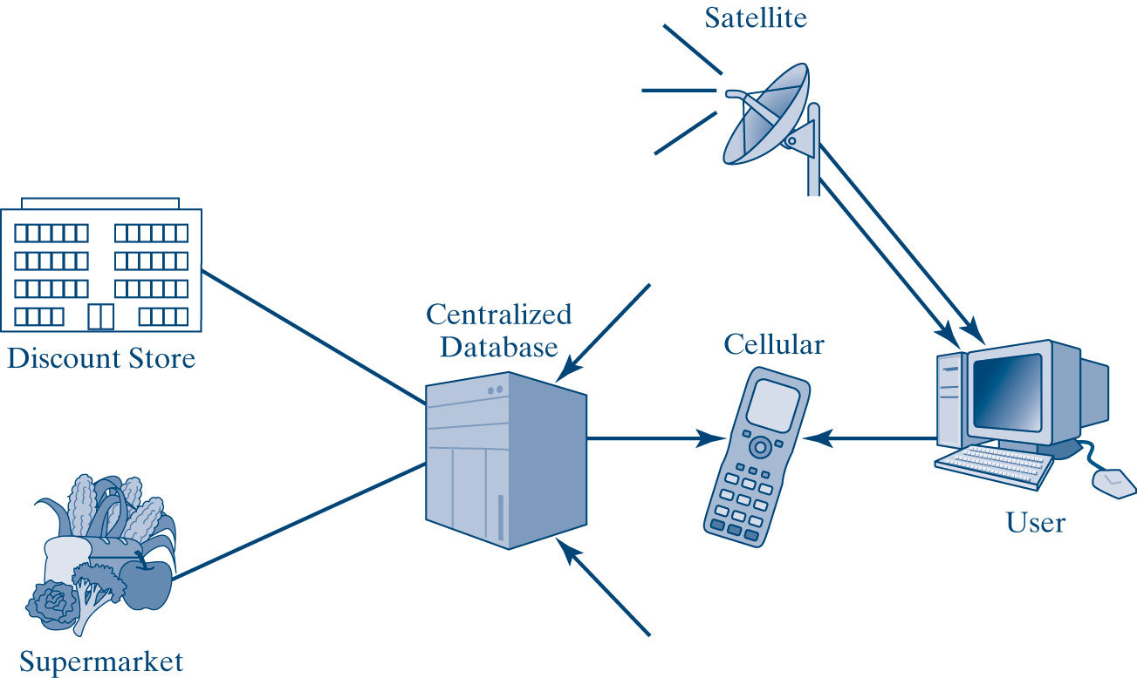
Mobile Product Locations
Source: U. Varshney, R. J. Vetter, and R. Kalakota. “Mobile Commerce: A new Frontier,” Computer, Oct. 2000, 3)
6-<number>

Slide 13
Wireless Application Protocol (WAP)
Designed to deliver messages and data traffic to mobile phones within a geographical area
Open, global, industry-wide mobile specifications for wireless network architecture, application environment, and a set of communication protocols
6-<number>

Slide 14
Wi-Fi (Wireless Fidelity)
Industry standard that makes it possible for hardware firms to create wireless products that communicate with one another
Access point spreads Internet access
Makes the work environment more mobile and easier to shift workspaces around within the firm
Security remains a major concern
6-<number>

Slide 15
Wi-Fi (continued)
Offices transmit data from a company’s intranet to employees on the move
Employees on the move can help companies reach suppliers and improve customer service
Wireless devices in a warehouse or a manufacturing facility can reduce handwritten reports and missed deliveries
Wireless devices open new shortcuts to stock trading, banking, and personal finances
6-<number>

Slide 16
Key Limitations
Distance
Speed
Security and privacy
Quality of service varies
Difficult for the user to remember all the phone numbers, keywords, or codes
Batteries have a poor record
6-<number>

Slide 17
Key Limitations (Cont’d)
Mobility does not matter when already overwhelmed with information at work
Connecting charges continue to be high
For certain destinations, a GPS in your car in not that useful
Immediate response is expected
No peace anymore in public places
Poor implementation of many wireless networks
6-<number>

Slide 18
Critical Success Factors
Mobility
Personalization
Global standardization
Customer profiling
6-<number>

Slide 19
Bluetooth
Universal, low-cost, low-powered wireless technology that uses short-range radio frequency (RF) to hook up wireless connectivity among computers, scanners, and printers
Allows any Bluetooth-enabled device to communicate with other similar devices, regardless of manufacture
Allows electronic devices to communicate and share information without action from a user, wires, or cables
Low complexity
Robust
6-<number>

Slide 20
Layered Bluetooth Architecture
Primary layer, called the radio layer, forms the physical connection interface that oversees transmission within a small network called a piconet
Second layer, is the baseband, which with a radio and an antenna makes up the physical transmission component of a Bluetooth device
Link manager protocol (LMP) is a Bluetooth layer that sets up ongoing link management with Bluetooth devices
  Piconet management
  Link configuration
  Security functions
6-<number>

Slide 21
Wireless Security Concerns
Transmitted message must be protected all the way to its destination host
Host system must verify or authenticate the user
Wired Equivalent Privacy (WEP) is part of Wi-Fi security mechanism that makes it possible to encrypt messages before heading for their destination
  Uses a secret key to encrypt messages
  40-bit key is standard but vulnerable
  Even the latest 128-bit key is not fully secure
6-<number>

Slide 22
Satellite Technology
“Long-haul” data transmission is made possible via satellites
Repeater in a satellite receives the signal representing the data and “repeats” the signal to another location
6-<number>

Slide 23
How Cellular Works
Network of cell sites distributed over a wide area
  Radio transceiver
  Base station controller
  Tower and antennas
Mobile telecommunications switching office (MTSO) is a cellular switch that places calls from land-based telephones to wireless customers
System identification code (SIC)
Controlled channel
Phone transmits a registration request
MTSO keeps track of the phone’s location in a database
6-<number>

Slide 24
How Cellular Works (Cont’d)
MTSO finds you and your phone in the database
MTSO picks up frequency that your phone will use in that cell
MTSO tells your phone over the control channel which frequencies to use
When your phone and the tower switch to those frequencies, the call is connected
6-<number>

Slide 25
Wireless LAN (WLAN)
Uses radio waves to connect laptops and other electronic devices to a LAN
Identical to a regular LAN, except that the devices are wireless
Wireless network interface card (WNIC) is a card that interfaces between the wireless device and an access point for data or voice transmission and reception
Access point (AP) is when a wireless station sends a frame to a server, an access point acts as a bridge that passes the frame over the wired LAN to the server
6-<number>

Slide 26
Factors When Considering WLAN
Range and coverage
Throughput
Security and integrity
Cost and scalability
User costs
Standardization of WLANs
6-<number>

Slide 27
Wireless Application Protocol (WAP)
Basis for the mobile Internet
Universal standard for positive wireless Internet implementation
Adds an Internet protocol layer to the cellular network
6-<number>

Slide 28
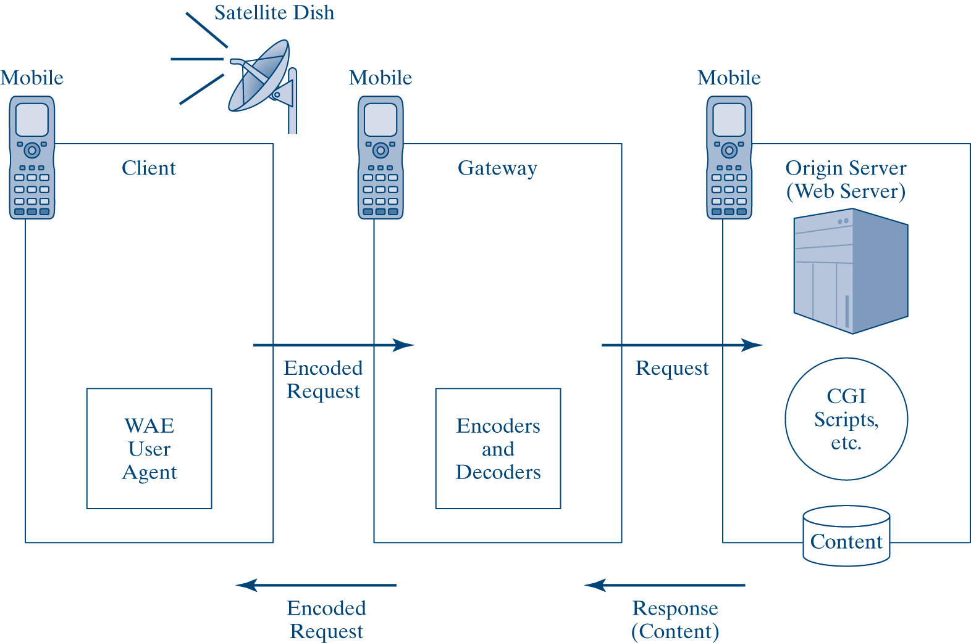
Schematic of the WAP Model
6-<number>

Slide 29
WAP Protocol Stack
 | Wireless Application Environment (WAE) | WAP element that establishes an interoperable environment to allow operators and service providers to build applications and services for a large variety of wireless platforms.
 | Wireless Session Protocol (WSP) | WAP element that decides whether a network and a device will communicate back and forth or whether data will be transmitted straight from a network to the device.
 | Wireless Transaction Protocol (WTP) | WAP layer that ensures that data flow from one location to another efficiently based on a request/reply paradigm
 | Wireless Transport Layer Security (WTLS) | WAP element that gives security to the system via encryption, data integrity verification, and authentication between the user and the server
 | Wireless Datagram Protocol (WDP) | WAP feature that confirms easy adaptation to the WAP technology
 | Network Carrier Method (NCM) | A technology that a wireless provider uses
6-<number>

Slide 30
WAP Limitations
Small keypad and without a mouse
Devices have limited memory
Reliability uncertain
A period of high latency or delays before making the connections
Security issues
Legal Issues
6-<number>

Slide 31
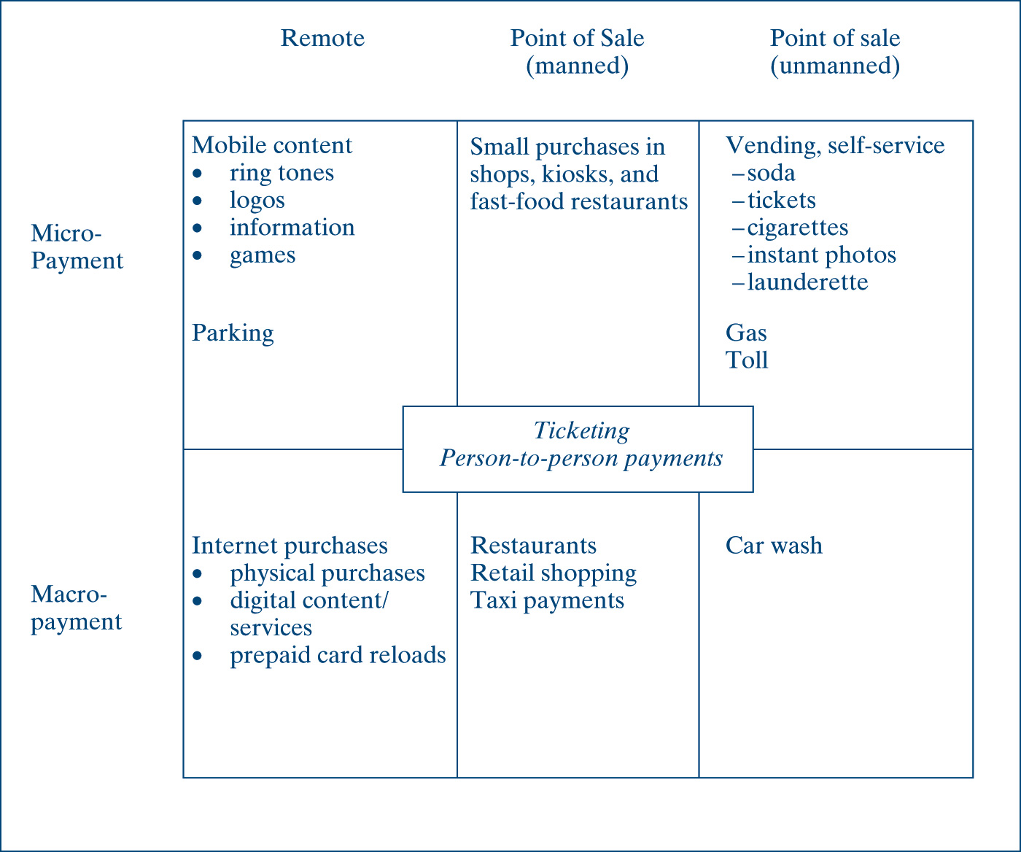
Mobile Payments Framework and Examples
6-<number>

Slide 32
Managerial Issues
Evaluate corporate needs
Evaluate the wireless needs
Send out a request for proposal (RFP)
Request a demo of the proposed wireless system
Install and test the wireless system
Train employees
Provide ongoing maintenance
Most important element is the human staff
Best practice to reduce costs is to standardize wireless devices
6-<number>

Slide 33
Trust Issues
Customers have an inherent resistance to sharing personal or private information with technology
Trust is a psychological state involving confident positive expectation about another person’s motive with respect to a given exchange or a relationship entailing risk
Gaining customer trust in m-commerce can be a daunting process
To enhance trust in mobile commerce, security must be designed into the entire mobile system
  Enhancing customer familiarity with the company
  Building a reputation that suggests certainty and less risk
  Providing attractive rewards to attract potential customers
  Maintaining company integrity
  Strengthening security controls
  Use external auditing
6-<number>

Slide 34
Implications for Management
M-commerce is long on technologies but short on standards
M-commerce opens doors to new ways of doing business
M-commerce will dominate areas where they have time-based and location-based value
Consider cultural and location-based issues
Prepare the company to offer mobile services that will be strategically advantageous to the business
Experiment with the new m-technology and view the whole effort as an investment in tomorrow’s way of doing business
6-<number>

Slide 35
Chapter Summary
M-commerce is the transmission of user data without wires
The wireless Web is a technological frontier, open and growing
The main benefits are convenience, flexibility, and efficiency with anytime, anywhere access
Wireless limitations address distance, speed, and security factors
Four critical success factors need to be monitored: mobility, personalization, global standardization, and customer profiling
6-<number>

Slide 36
Chapter Summary (Cont’d)
Bluetooth is a universal, low-cost wireless technology designed for short-range radio hookup for wireless connections among computers, scanners, and printers
Key layers of Bluetooth are the radio layer, baseband layer, and link manager protocol
The transmitted message must be protected all the way to its destination, and the host system must verify or authenticate the user it is communicating with
2G digital cellular technology expedites vehicles in motion
6-<number>

Slide 37
Chapter Summary (Cont’d)
A cell site contains a radio transceiver and a base station controller
Cell sites coordinate the hand off as you move from one cell to another
The most common standard for wireless networking is the WLAN
To consider WLAN technology, you must consider range and coverage, throughput, security and integrity, cost and stability, and standardization
Most WAP benefits are reflected in wireless applications
6-<number>

Slide 38
Chapter Summary (Cont’d)
WAP has the limitations of low-power CPU, small screens with questionable clarity, limited device memory, small keypads and no mouse, questionable connections for reliability, and high latency
Companies are beginning to consider the liability issues, as well as managerial issues
6-<number>

